Slide 2
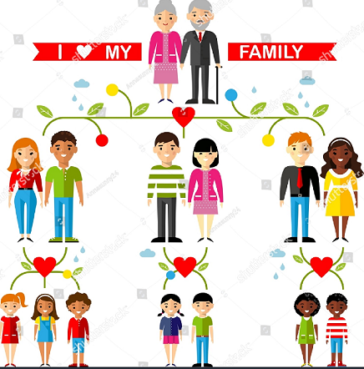
My family picture

Slide 3
My family photo

Slide 4
Who is who, in my family
My (step)mother is…..
She is ….. (how old?)
She works as a …..
My (step)father is…..
He is ….. (how old?)
He works as a …..
I have got …. sisters and …. brothers.
She/he/they are called …..
My brother(s)/sister(s) is/are ….. (how old?)
He/she studies…./works as a …..
My pet(s) are ….
I have got …. uncles/aunts

Slide 5
Photos of the rest of my family
Don’t forget: who is who?

Slide 6
This is my home and my room

Slide 7
Photos of my friend(s)
Don’t forget: who is who?

Slide 8
This is what I like to do

Slide 9
This is what I do NOT like to do

Slide 10
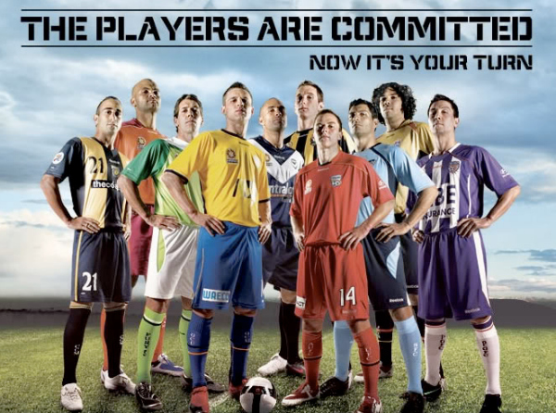
This is my favourite artist or DJ or athlete or moviestar or……..

